Slide 1
Comprehensive Digital Marketing
Project Work of LAKME

Slide 2
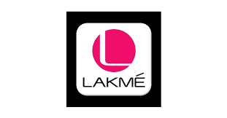
Part 1: Brand study, Competitor Analysis & Buyer’s/Audience’s Persona
Research Brand Identity: Study the brand's mission, values, vision, and unique selling propositions (USPs).
Brand Colours : Pink , White
Logo:
Lakmé is an Indian cosmetics brand, owned by Hindustan Unilever. It was named after the French opera Lakmé, which itself is the French word for goddess Lakshmi who is renowned for her beauty.

Slide 3
Part 1: Brand study, Competitor Analysis & Buyer’s/Audience’s Persona
Mission/Values:
Lakme mission is to become An Ally To The Classic Indian Woman, Lakme Inspires Her To Express The Unique Beauty And Sensuality Within Enabling Her To Realize The Potency Of Her Beauty.
Innovation
Quality
Inclusivity
USP:
Lakme brings expert products and services that are borne out of true understanding of the needs of the Indian.
Timeless Beauty: Lakme is a brand that has stood the test of time, with a rich heritage dating back to 1952. Over the years, it has become synonymous with beauty, elegance, and quality. The brand has earned the trust and loyalty of generations, making it a symbol of timeless beauty in the cosmetics industry.
Tagline: Effortlessly, Fashionably, Unapologetically MÉ. LAKMÉ.

Slide 4
Part 1: Brand study, Competitor Analysis & Buyer’s/Audience’s Persona
Analyze Brand Messaging:
Lakme's brand messaging focuses on empowering women.
By providing high-quality cosmetics and beauty products,
Lakme aims to boost women's confidence and help
Them feel their best. Their messaging conveys the belief that when women feel confident, they can conquer the world.
EXAMINE THE BRAND”S TAGLINE :
Starting around my last update in September 2021, Lakmé's slogan was "A Lakmé young lady isn't just about excellence. She is an outflow of excellence." It's essential to take note of that brand slogans can change over the long haul, so checking this data with the latest sources is suggested.

Slide 5
Part 1: Brand study, Competitor Analysis & Buyer’s/Audience’s Persona
Competitor Analysis: Select three competitors operating in the same industry or niche as the chosen brand, examine their USPs and online communication.
Competitor 1:
Maybelline New York:https://www.maybelline.co.in/
USP: Maybelline New York positions itself as a trendy, affordable, and innovative cosmetics brand. Its USP lies in offering a wide range of makeup products that cater to diverse skin tones and makeup preferences. The brand often focuses on the latest fashion trends and appeals to a younger audience seeking contemporary and accessible beauty products.
Competitor 2 :
L'Oréal Paris: https://www.lorealparis.co.in/
USP: L'Oréal Paris is known for its high-quality and luxurious beauty products that cater to a wide range of demographics. Their USP lies in combining science and beauty, with a focus on product efficacy and innovation. They often position themselves as a brand that empowers women and celebrates diversity, offering beauty solutions for various skin types and ages.
Competitor 3 :
Revlon: https://revlon.co.in/
USP: Revlon positions itself as a notorious and immortal beauty care products brand, offering a blend of exemplary and contemporary excellence items. Their USP lies in giving superior grade, stylish cosmetics at reasonable costs. They center around inclusivity, giving a different scope of shades and items reasonable for different complexions and inclinations.

Slide 6
Part 1: Brand study, Competitor Analysis &
Buyer’s/Audience’s Persona
Buyer's/Audience's Persona: Clearly define the target audience for the chosen brand. Consider demographics, psychographics, behaviours, and interests.
Demographics:
Gender: Primarily female. While some products may appeal to a broader audience, Lakmé predominantly targets women.
Age: Lakmé caters to a wide age range, but its core audience is likely to be young adults and working professionals in their 20s to early 40s.
Geographic Location: As a popular Indian brand, Lakmé's primary market is India. However, it may have an international presence in regions with a significant Indian diaspora.
Psychographics:
Aspirational: Lakmé's target audience is likely to be aspirational, seeking to enhance their beauty and style.
Fashion-conscious: The audience is interested in keeping up with the latest fashion trends and looks.
Confident and Independent: Lakmé's consumers may exhibit traits of confidence and independence, valuing products that help them express their individuality.

Slide 7
Part 1: Brand study, Competitor Analysis &
Buyer’s/Audience’s Persona
Behaviors:
Beauty Enthusiasts: The target audience is interested in makeup and beauty products, enjoying experimenting with different looks.
Tech-savvy: The audience is likely to be active on social media and digital platforms, seeking beauty trends and makeup tutorials online.
Brand Loyalty: Lakmé has a loyal customer base, and its audience may exhibit brand loyalty due to the consistent quality and reputation of the brand.
Interests:
Makeup and Beauty: The primary interest of Lakmé's audience is makeup, beauty products, and skincare.
Fashion and Style: The target audience is likely to have an interest in fashion and personal style, seeking products that complement their overall look.
Celebrities and Influencers: Lakmé's audience may be influenced by celebrities and beauty influencers who endorse the brand's products.

Slide 8
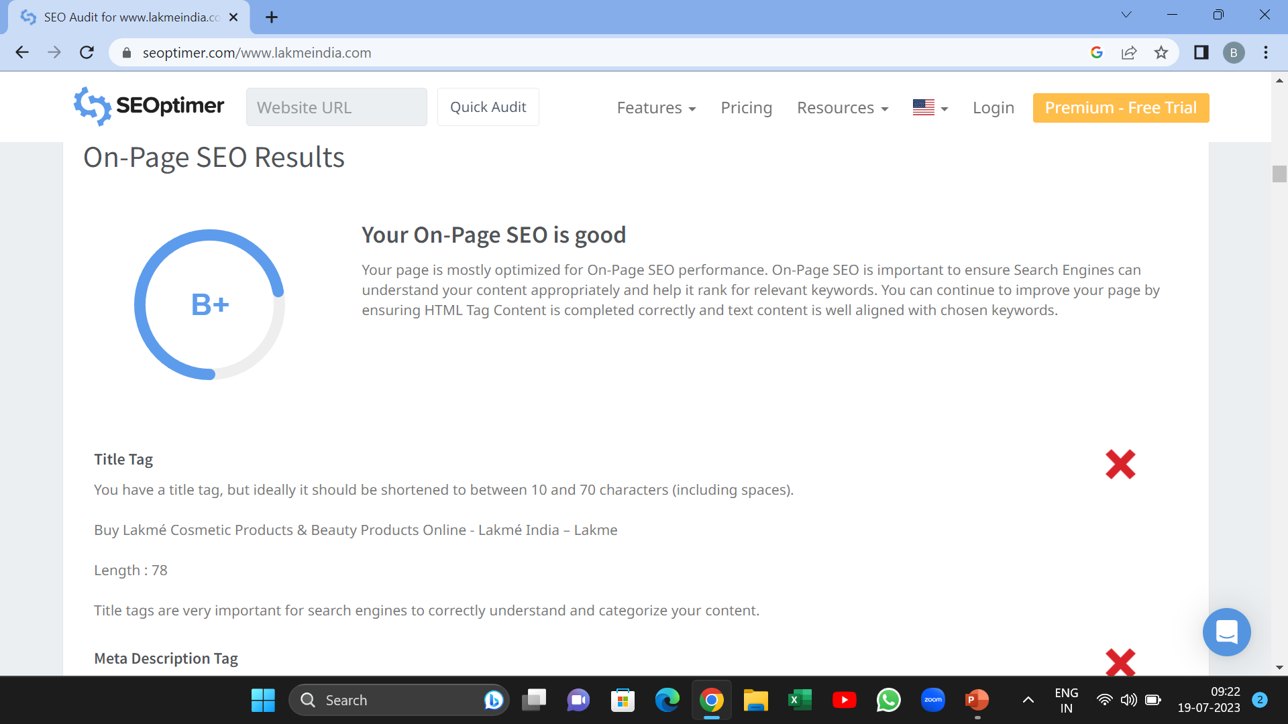
Part 2: SEO & Keyword Research
SEO Audit: Do an SEO audit of the brands website
An SEO audit is a comprehensive evaluation of a website's search engine optimization (SEO) performance and overall health. The main purpose of an SEO audit is to identify areas of improvement and uncover issues that may be hindering the website's ability to rank well in search engine results. The SEO audit for lakme is as follows:
Technical SEO: Check for any crawl errors using tools like Google Search Console. Ensure the website is mobile-friendly and responsive. Verify the site's loading speed and optimize if necessary. Make sure all important pages are indexed by search engines.

Slide 9
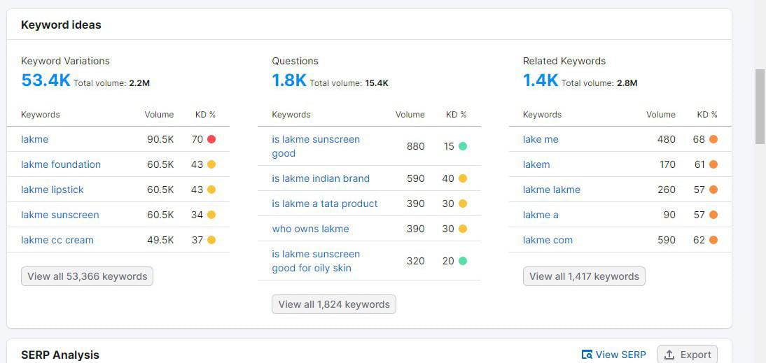

Slide 10
Part 2: SEO & Keyword Research
Company: Lakme
Keyword Research Objective:
Keyword research is essential for any brand or product to enhance its online
presence and reach its target audience effectively. For Lakme, a well-known
beauty and cosmetics brand, conducting keyword research is crucial to
understand what potential customers are searching for and to optimize their
online content accordingly.
Keyword Research:
Conduct through keyword research to identify relevant and high-value keywords related to Lakme products, beauty trends, and cosmetics industry. Use these Keywords and insert into the content to get more organic traffic .
Brand-related Keywords:
Lakme
Lakme cosmetics
Lakme makeup
Lakme beauty products https://youtu.be/xpFMXPt_98c
Lakme skincare

Slide 11
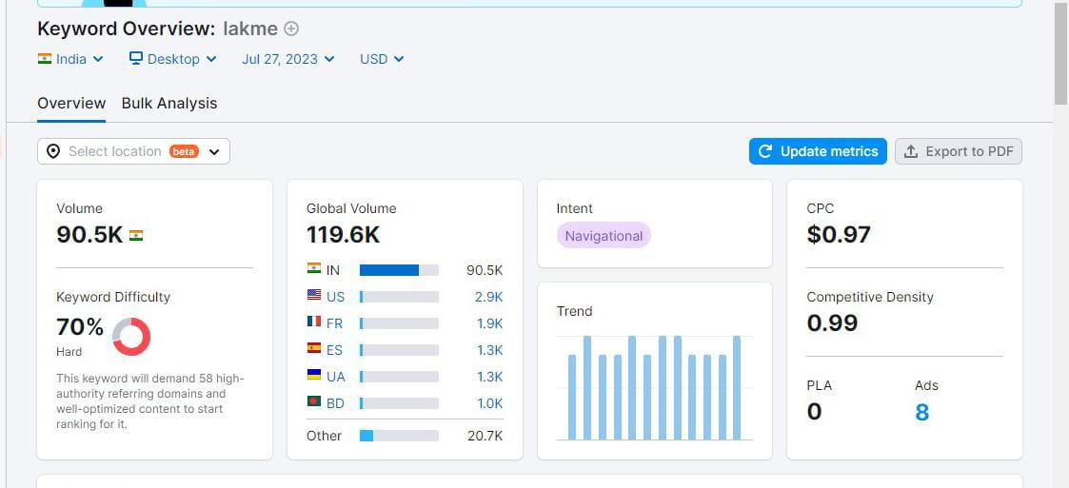
Keyword Research for LAKME :

Slide 12
Keyword Research Stats:
SNO | Keyword | Monthly Searches | Competition
1 | Lakme Lipstick | 74,000 | HIGH
2 | Lakme cc cream | 90,000 | HIGH
3 | Lakme Foundation | 90,500 | HIGH
4 | Lakme Mascara | 8,100 | HIGH
5 | Lakme Kajal | 22,200 | HIGH
6 | Lakme Eye Liner | 22,200 | HIGH
7 | Lake Facewash | 40,500 | HIGH

Slide 13
Part 2: SEO & Keyword Research
On Page Optimization:
Meta Tag Optimization: For optimizing meta tags in digital marketing for Lakmé products (a popular cosmetics brand), you need to focus on relevant keywords, compelling descriptions, and Unique titles that will attract Target Audience and improve search engine visibility. Follow the Below steps for Meta tag optimization :
Keyword Research:
First identify the seed keywords for the Lakme products in keyword tools like Google keyword planner, SEMrush , Moz Keyword Explorer.
Title/Meta Tag :
Create unique and descriptive title tags for each product page using Keywords. We have to create tags within 50-60 Characters .Title tags are helpful to get results of the webpage in search engines.
Meta/Title Description :
Write the description about the topic using relevant Keywords . Write the description within150-160 characters in the webpage

Slide 14
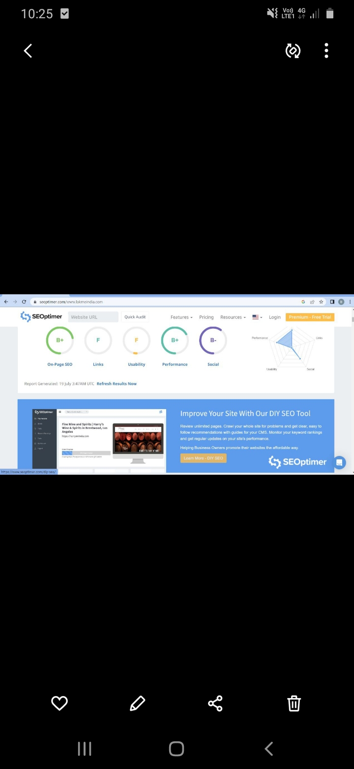

Slide 15
Part 3: Content Ideas and Marketing Strategies
Content Idea Generation & Strategy:
Content Calendar: The remaining month of July content calendar
Lakmé, being a famous beauty care products brand, can make different substance types to draw in its main interest group, feature its items, and support its image character. Here are a few substance thoughts and methodologies that Lakmé can consider carrying out:
Cosmetics Instructional exercises and How-To Guides:
Make video instructional exercises displaying different cosmetics looks utilizing Lakmé items.
Offer bit by bit directs for accomplishing explicit looks, like marriage cosmetics, party cosmetics, or regular cosmetics.
Team up with cosmetics specialists and magnificence powerhouses to highlight their one of a kind cosmetics strategies utilizing Lakmé items.

Slide 16
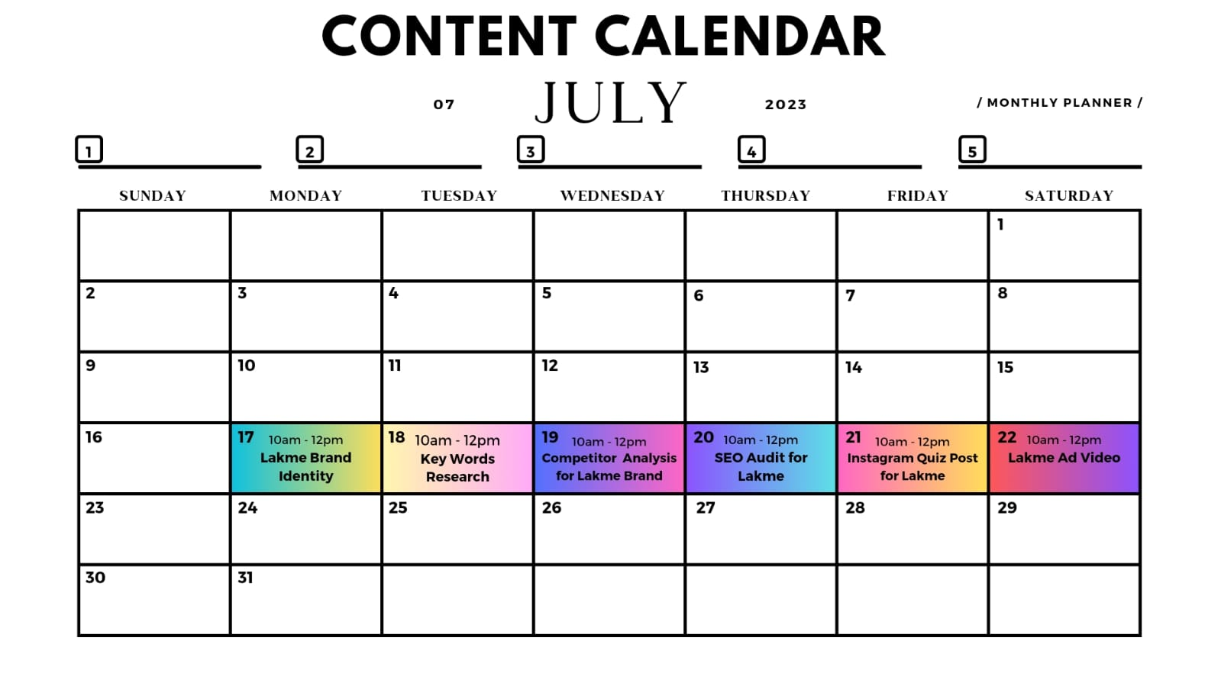

Slide 17
Part 3: Content Ideas and Marketing Strategies
Challenges Encountered:
Contest in the Beauty care products Market: The makeup business is exceptionally cutthroat, with various brands competing for shopper focus. Lakmé faces rivalry from both homegrown and worldwide brands, requiring ceaseless advancement and compelling showcasing systems to remain ahead.
Changing Shopper Inclinations and Patterns: Excellence patterns and purchaser inclinations can change quickly. Staying aware of these movements and adjusting item contributions appropriately can challenge.
Virtual Entertainment Investigation and Powerhouse The board: With a solid internet based presence, brands like Lakmé need to painstakingly oversee web-based entertainment connections and force to be reckoned with organizations. Negative criticism or contentions can immediately spread and effect the brand's standing.
Supportability and Moral Worries: Shoppers are progressively aware of maintainability and moral practices. Lakmé might confront strain to line up with eco-accommodating and remorselessness free drives, which can include changes in bundling, fixing obtaining, and creation techniques.

Slide 18
Part 3: Content Ideas and Marketing Strategies
Lessons Learned:
Customer-Centric Approach: Brands like Lakmé must prioritize understanding their customers' needs and preferences. Gathering feedback and conducting market research helps in developing products and campaigns that resonate with the target audience.
Innovation and Adaptation: The cosmetics industry rewards innovation and the ability to adapt to changing trends. Lakmé should continuously invest in research and development to create new and relevant products.
Authenticity and Transparency: Building trust with consumers is vital. Lakmé can prioritize transparency in ingredient sourcing, manufacturing processes, and claims made about their products.
Social and Environmental Responsibility: Embracing sustainability and ethical practices can enhance the brand's reputation and appeal to conscious consumers. Commitment to responsible initiatives should be communicated clearly to consumers..

Slide 19
Part 4: Content Creation and Curation (Post creations, Designs/Video Editing, Ad Campaigns over Social Media and Email Ideation and Creation)
Post Creation:
Format 1: Blog Article
Aim : Boost SEO & Provide information about LAKME Products.
Date : 24th July 2023
Topic:Discover the Absorbing Beauty of Lakme Luminous Skin Cream: A
Guide to Radiant Skin
https://www.blogger.com/u/1/blog/posts/3224858278132641426

Slide 20
Part 4: Content Creation and Curation (Post creations, Designs/Video Editing, Ad Campaigns over Social Media and Email Ideation and Creation)
Format 2: Video
Date : 20th July 2023
Topic: Brand advertisement
Drive Link:
https://youtu.be/KStEXFt3hxA

Slide 21
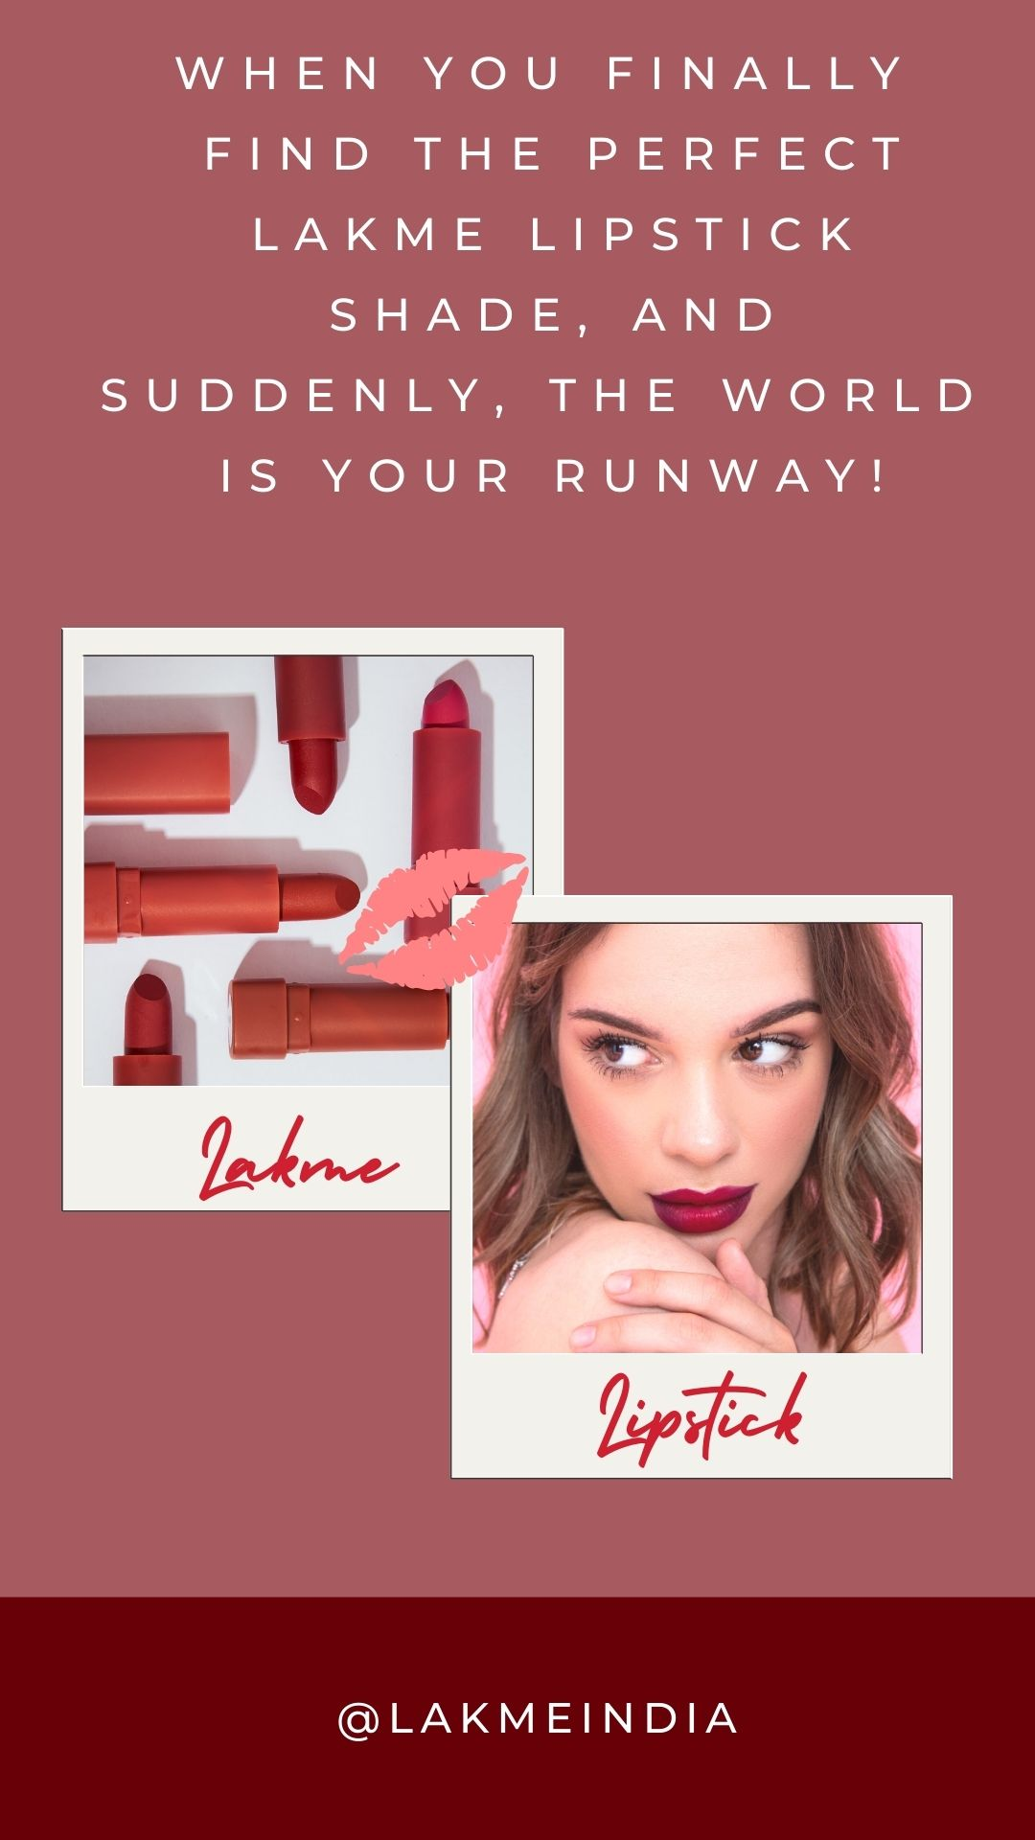
Part 4: Content Creation and Curation (Post creations, Designs/Video Editing, Ad Campaigns over Social Media and Email Ideation and Creation)
Format 3: Creative Meme
Date:20th July 2023
Topic: Lakme Lipstick
Meme: To create a meme on lakme.

Slide 22
Part 4: Content Creation and Curation (Post creations, Designs/Video Editing, Ad Campaigns over Social Media and Email Ideation and Creation)
Instagram Story
We have created three Instagram stories on Lakme and screenshots and those are provided below:

Slide 23
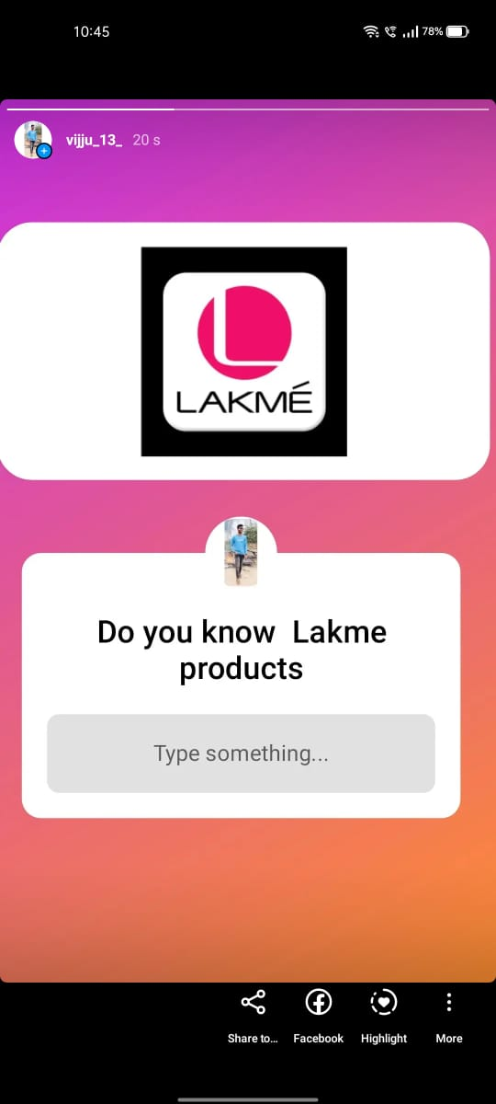
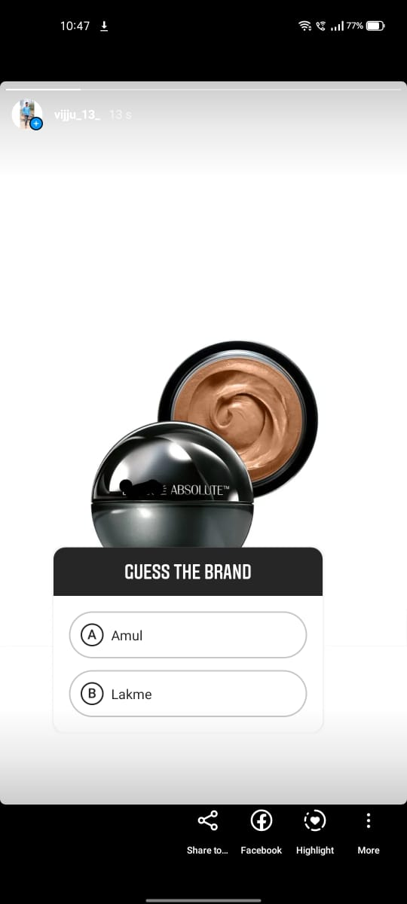
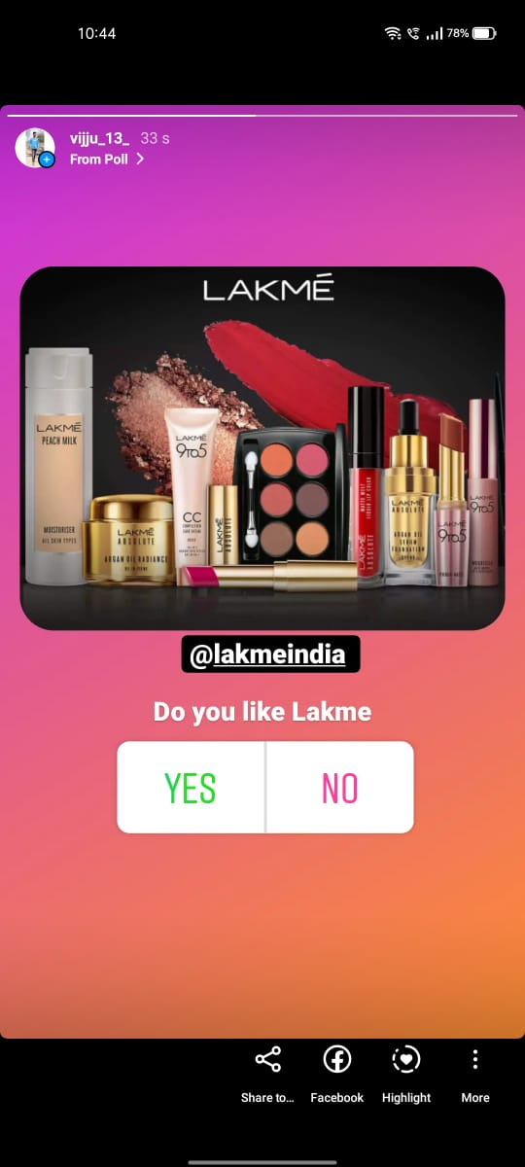

Slide 24
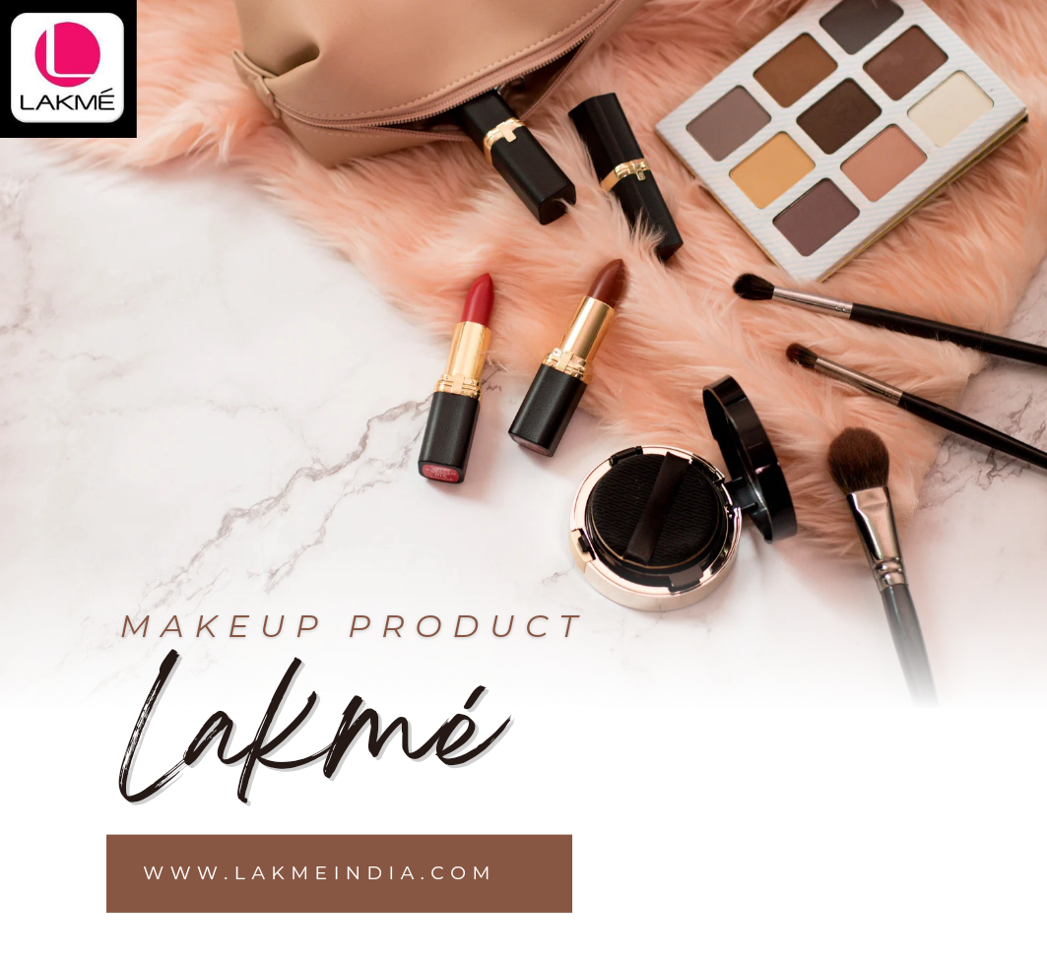
Part 4: Content Creation and Curation (Post creations, Designs/Video Editing, Ad Campaigns over Social Media and Email Ideation and Creation)
Designs/Video Editing
Design:
Video Creation: Advertisement video on Lakme
Link: https://youtu.be/fg935OK4AXQ

Slide 25
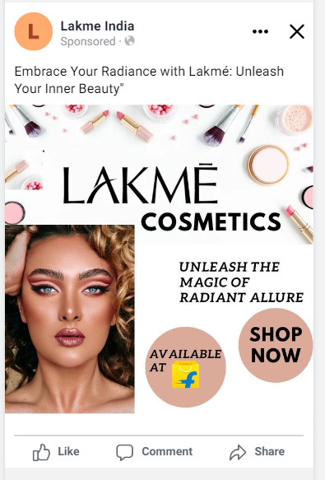
Part 4: Content Creation and Curation (Post creations, Designs/Video Editing, Ad Campaigns over Social Media and Email Ideation and Creation)
Social Media Ad Campaigns
Reach and Frequency: Aim to maximize the reach of advertisements to expose brand to as many potential customers as possible. Additionally, consider the frequency of your ads to ensure that your message is seen and heard repeatedly, reinforcing brand recognition.
Storytelling: Craft compelling and consistent brand stories across different advertising channels to create a lasting impression in the minds of consumers. Storytelling helps create an emotional connection with your audience and makes your brand more memorable.

Slide 26
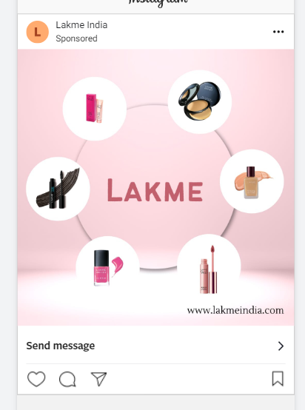
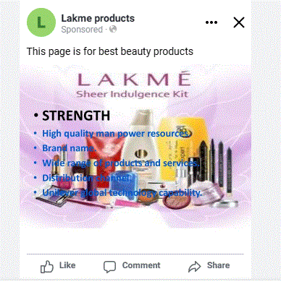
Social Media Ad Campaigns

Slide 27
Part 4: Content Creation and Curation (Post creations, Designs/Video Editing, Ad Campaigns over Social Media and Email Ideation and Creation)
Email Ad Campaigns
Ad Campaigns for email marketing:
Brand Awareness: Brand awareness refers to the extent to which consumers recognize and recall a particular brand. It is a crucial marketing metric that reflects the brand's visibility, familiarity, and recall among the target audience. Building strong brand awareness helps increase customer trust, loyalty, and preference for the brand's products or services.
Lead generation: Lead generation is the process of attracting and capturing potential customers (leads) who show interest in a company's products or services. It involves various marketing strategies, such as content marketing, social media, and email campaigns, to generate interest and collect contact information for follow-up and conversion into paying customers.

Slide 28
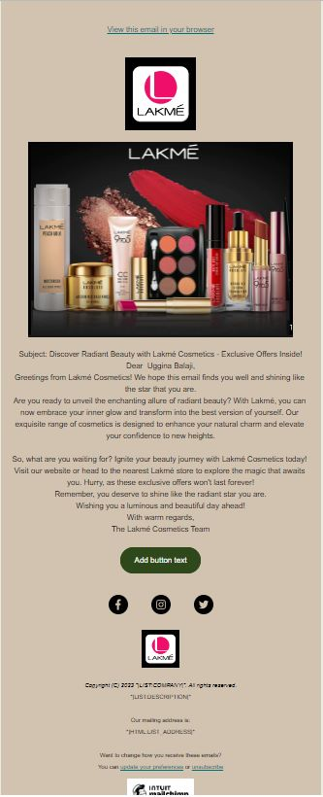
Email Ad Campaign 1 - Brand Awareness
(insert emailer image)

Slide 29
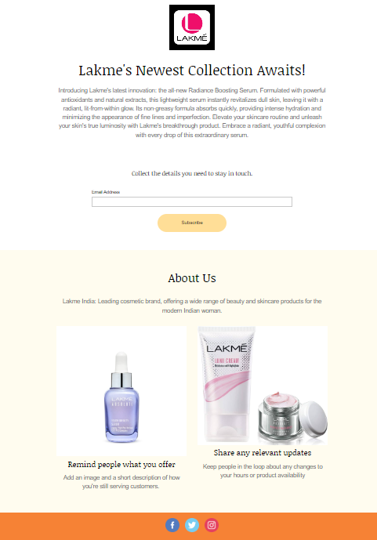
Email Ad Campaign 2 - Lead Generation
(insert emailer image)

Slide 30
Part 4: Content Creation and Curration (post creations, designs/video
Editing, ad campaigns over social media and Email idation and creations)
Reflect on the content creation and curation process, discussing the challenges
faced and lessons learned.
Content creation and curation are crucial aspects of a brand's marketing strategy, and for a well-known cosmetic brand like Lakme, it is essential to maintain a consistent and engaging online presence. Let's discuss the content creation and curation process for Lakme, along with the challenges they might face and the lessons they could learn.
Challenges Faced:Remaining Significant and Stylish: The magnificence business is steadily developing, and Lakme should continually stay aware of the most recent patterns and advancements to stay pertinent and interesting to its ideal interest group.
Adjusting Limited time and Non-Special Substance: Finding the right harmony between special substance and significant, non-limited time content can challenge. Crowds lean toward content that teaches, engages, or takes care of their concerns as opposed to simply being barraged with deals pitches.

Slide 31
Lessons Learned:
Consistency Matters: Routinely presenting content and sticking on a predictable brand voice helps in building a dependable and drew in crowd.
Embrace Credibility: Validness is critical to interfacing with shoppers. Lakme ought to zero in on being certified and straightforward in its substance creation and correspondence.
Pay attention to Clients: Focusing on client criticism and inclinations assists in fitting with satisfying that tends to their necessities and wants.
Adjust to Patterns Carefully: While it's vital for stay refreshed with patterns, few out of every odd pattern could line up with Lakme's image personality. Picking the right patterns to follow is vital.

